Slide 1
Alyssa Bryant, Will Edison, Tobin Kassa, David Melvin, Casey Miller, Erin Schmidt

Slide 2
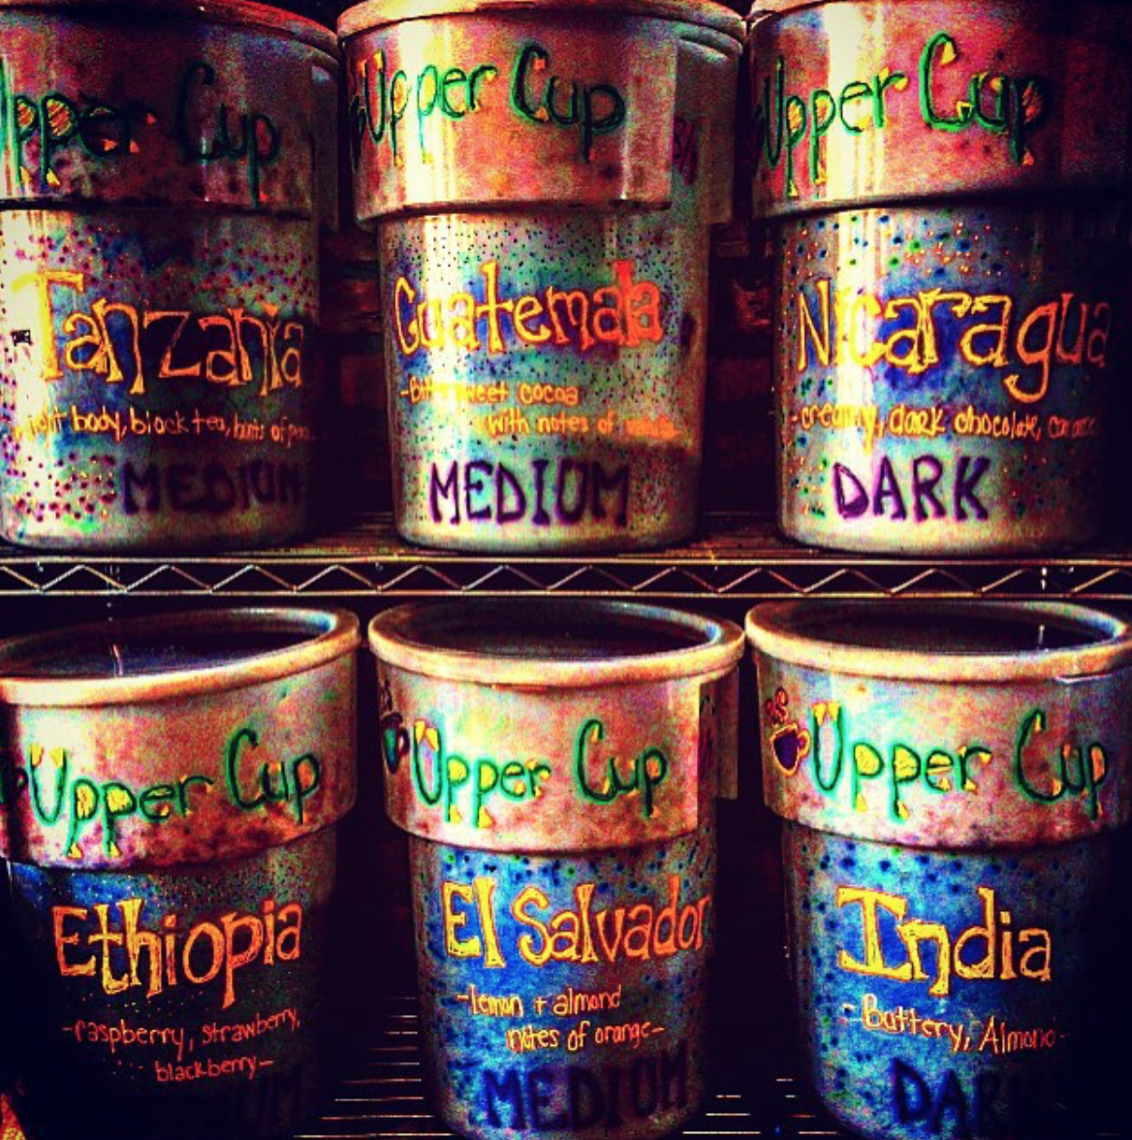
Background
Inspired by the traditional coffee ceremony in owner, Micael Habte’s home in Eritrea, Africa
Upper Cup began as a wholesale operation selling coffee beans originating from Eritea, now sell from all over the world
In September 2011, he opened his first retail location in Columbus, OH, on Parsons Avenue
Opened a second location in Gahanna, Oh, in May 2017
Habte’s vision is to create a space for families and friends to gather where they can enjoy anything from a cup of coffee, a donut or a meal
Notes:
Erin

Slide 3
Research
Active instagram- receive 50-100 likes on most posts from their 1,598 followers
Their Twitter account hasn’t published a tweet since December 2014, before the Gahanna branch even opened
Website weak in a few areas
No phone number for new Gahanna location
No links to Facebook and Instagram
News tab has no content
A lot of white space
Notes:
Casey

Slide 4
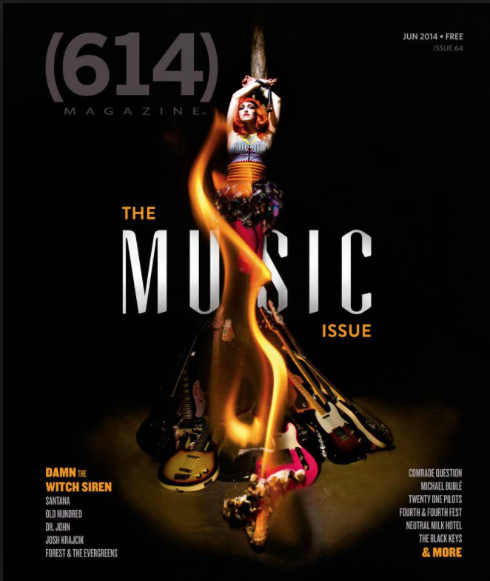
Interview
Wanted to put more emphasis in promoting Gahanna location
Habte placed an ad in 614 Magazine for $300/month
Has rented out the Gahanna location to use it for events like “Coffee with Cops,” a website launch and more
Has collaborated with the Gahanna Pigskin Brewery Company, used its coffee as a base for one of their beer specials along with serving Upper Cup’s “homer doughnuts.”
Notes:
Tobin

Slide 5
Communication Analysis
Lack of collateral items
Need more definite social media presence
Facebook and Twitter barely in use
Instagram used consistently, increasing engagement
The website does not communicate much information about the new Gahanna location or include the additional products offered outside of coffee
Link to social media accounts not available
There is no content under the “New” tab
Notes:
Casey

Slide 6
SWOT Analysis
Strengths Established brand, evidenced by opening of the second location in Gahanna Values are consistent, focused on local communities near shops Affordable prices on coffee | Weaknesses Lack of advertisement Oversaturated market within coffee industry Lack of consistent social media presence
Opportunities Focus on food products $1,000 advertising grant | Threats Koko’s Bakery, local company across the street. Focused mostly on fine pastries, but also sells coffee and teas Blank Slate Coffee, a local food truck in Gahanna that sells coffee Established brands like Dunkin’ Doughnuts, Tim Hortons and Panera in town
Notes:
Will and David

Slide 7
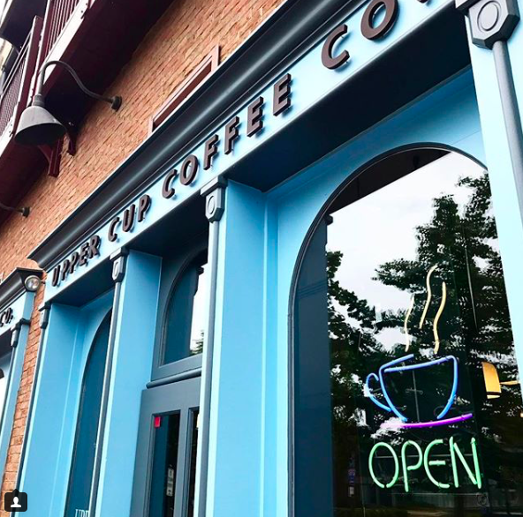
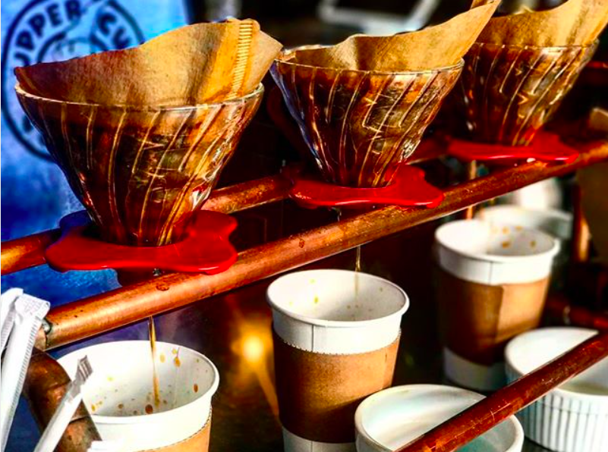
Two Main Objectives:
Increase brand awareness with new location in Gahanna
Increase sales with new products (donuts) and emphasis on in-house roasted coffee.
Notes:
Tobin

Slide 8
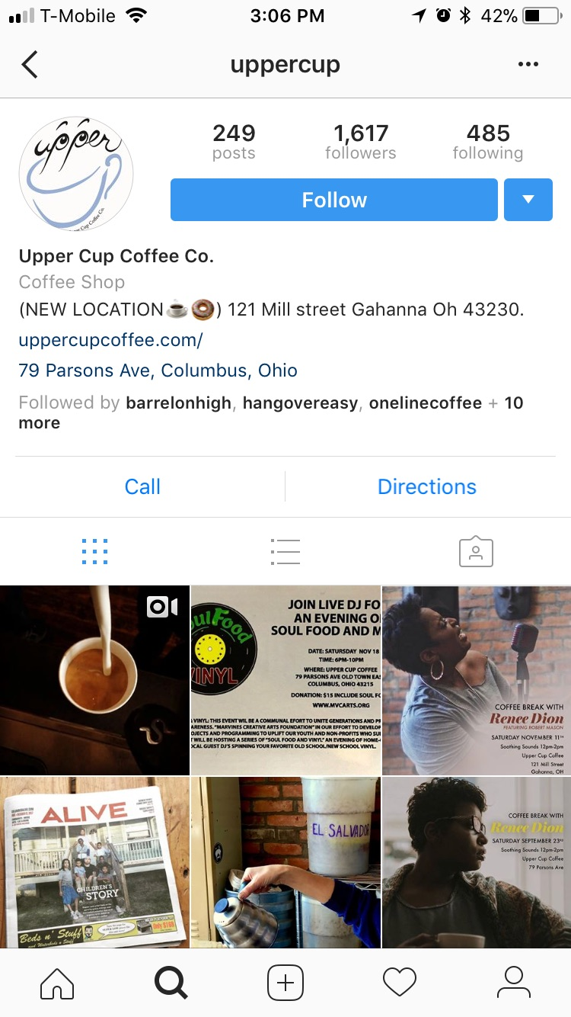
Recommendations
Monthly Donut Decorating Events
Attract families, promote donuts
Business Card Drawings
Reward customers, collect customer emails
Prize Donation to Gahanna Gala
Reach parents, earn sponsor spot
Use Messaging Document
Better employee-generated content
Delete Twitter
No one maintaining, posting
Update Website
Better mobile interface
Link to Instagram
Notes:
Alyssa

Slide 9
Collateral Items
Notes:
Alyssa

Slide 10
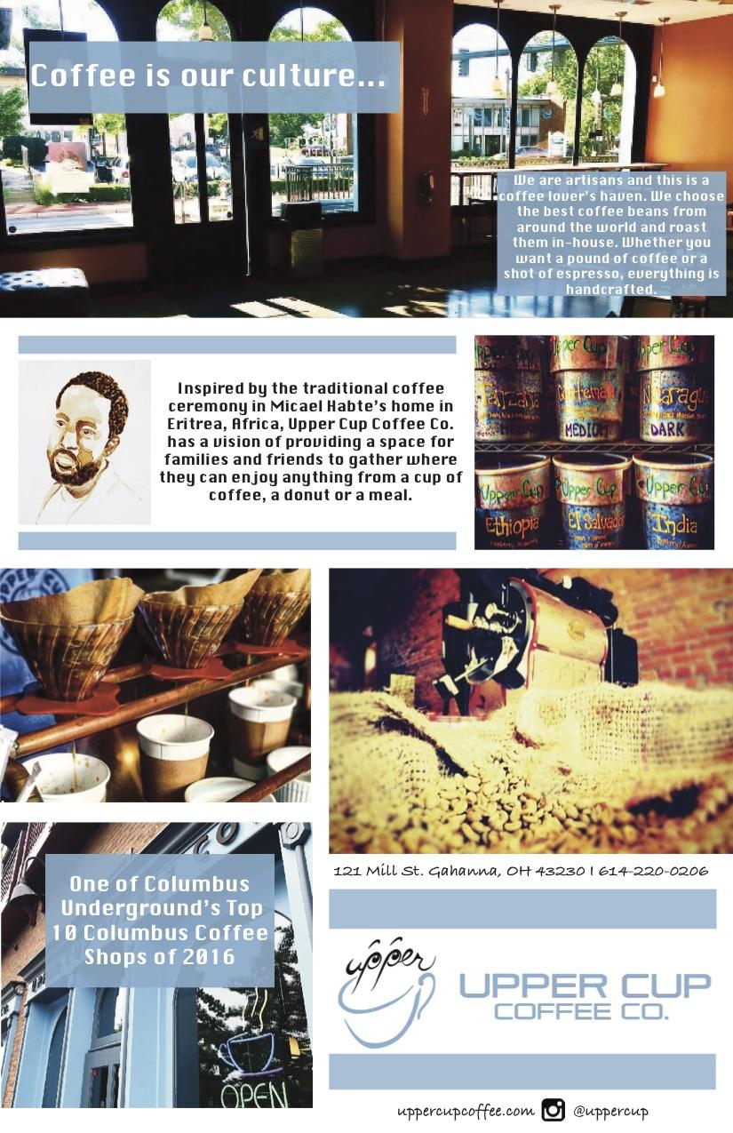
Promotional Flier
Aimed to help potential customers get a feel of the culture of Upper Cup and create a positive image
Will be passed out at events that Upper Cup attends, such as the annual Holiday Lights event in Gahanna
A stack will also be placed somewhere in the shop for people to take a share with friends
Notes:
Erin

Slide 11
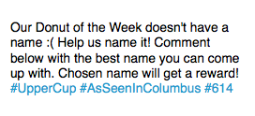
Instagram Content Calendar
Promotional posts:
“Donut of the Week”
Non-promotional posts that help highlight that Upper Cup:
Is a community shop
Has strong ties to the Ethiopian and Eritrean community in Columbus
Hashtags, account tags, links
Generate awareness and visibility in the Columbus community
Notes:
Tobin

Slide 12
Design-A-Donut Flier
Attract families, promote donuts
Sunday afternoons = good time for families
Designed to appeal to children
Low cost
Flat shapes, colors = no need for premium printing or specialty paper
Monthly, evergreen = no need for replacement
Placement
Schools, churches, community centers (YMCA)
Laminated (more permanent): in Upper Cup, around Creekside, local pools, parks, and athletic fields through Gahanna Parks and Rec

Slide 13
Messaging Document
Upper Cup is more than a coffee shop.
Upper Cup is an active member of its local communities.
Upper Cup is deeply connected and highly supportive of the Columbus Ethiopian and Eritrean community.

Slide 14
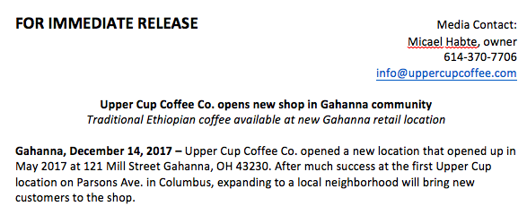
News Release - Gahanna Location
Informs the public of new retail location on Mill Street
Highlights new products available at Gahanna location, not Parsons location
Emphasizes family-friendly environment
Reaches out to young professionals
Will be sent to Gahanna’s local newspaper and ThisWeek Community News
Notes:
Casey

Slide 15
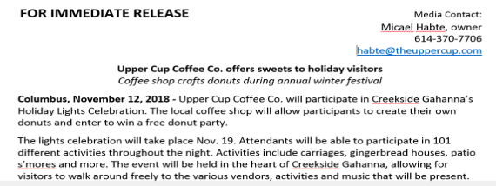
News Release- Gahanna Lights Event
Highlighted Gahanna Lights Celebration and Upper Cup’s involvement
Upper Cup created a donut contest for visitors
150 people attended the event, prompting owner to want to do the same activity next year

Slide 16
Client Feedback
-
“Wow, this is some really good insight!! Thank you”
Notes:
Alyssa

